Slide 1


Website
A/B test
Gabriela & Davide

Slide 2
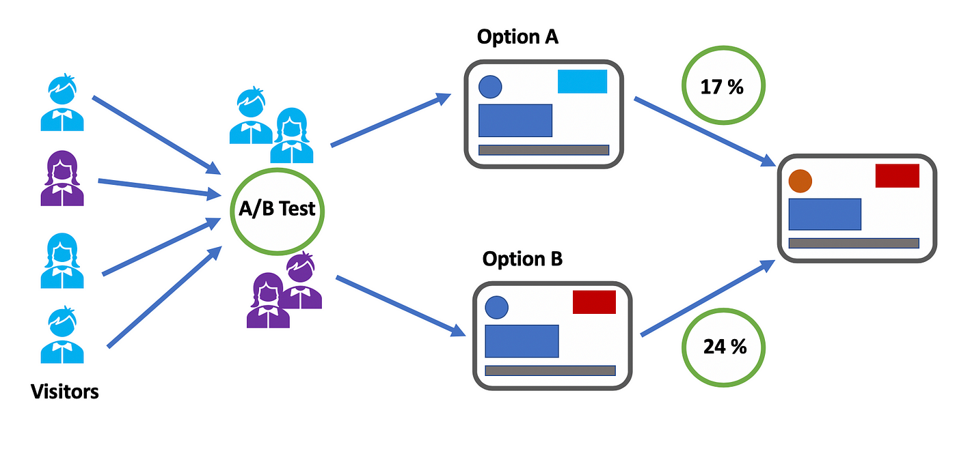
A/B test
X%
Y%
Has the new User Interface improved the Completion Rate?
Notes:
Our executive has requested an A/B test to compare the new and old user interfaces of our online services. The goal is to determine if the completion rate has improved by at least 5%, which would justify the development costs and ensure profitability.

Slide 3

Data Analysis
Behaviour
Demographic
Variation (A/B)
KPIs
Clean & Check Data Frames
Analise relationships and create new data sets to work with (Python & Tableau)

Slide 4
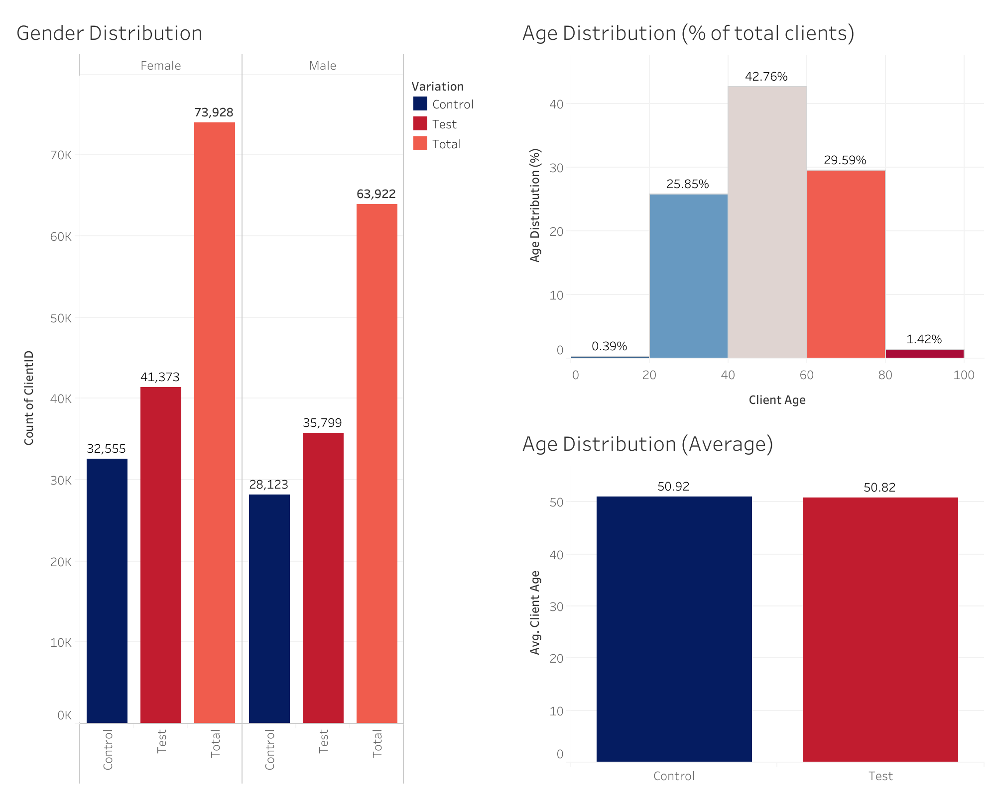
Demographic Distribution

Slide 5
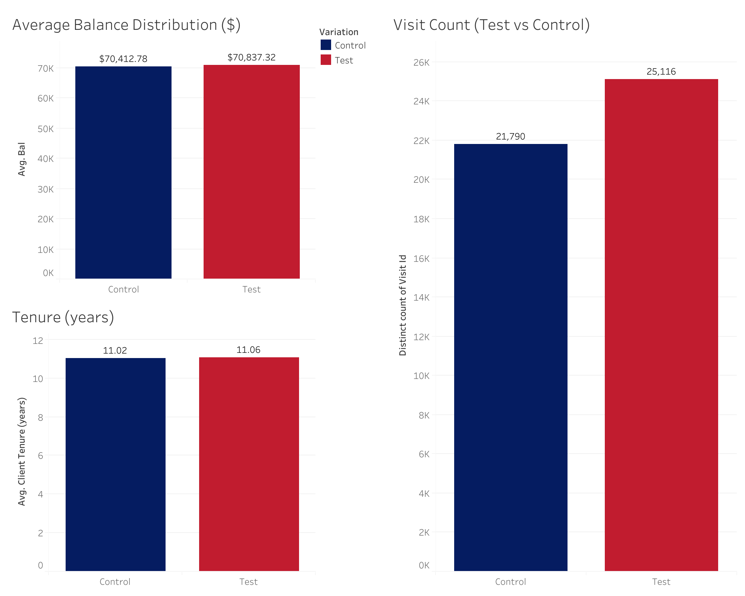
Client Behaviour

Slide 6



Key Performance Metrics
Time Spent
per Step
Error Rate
Completion Rate

Slide 7
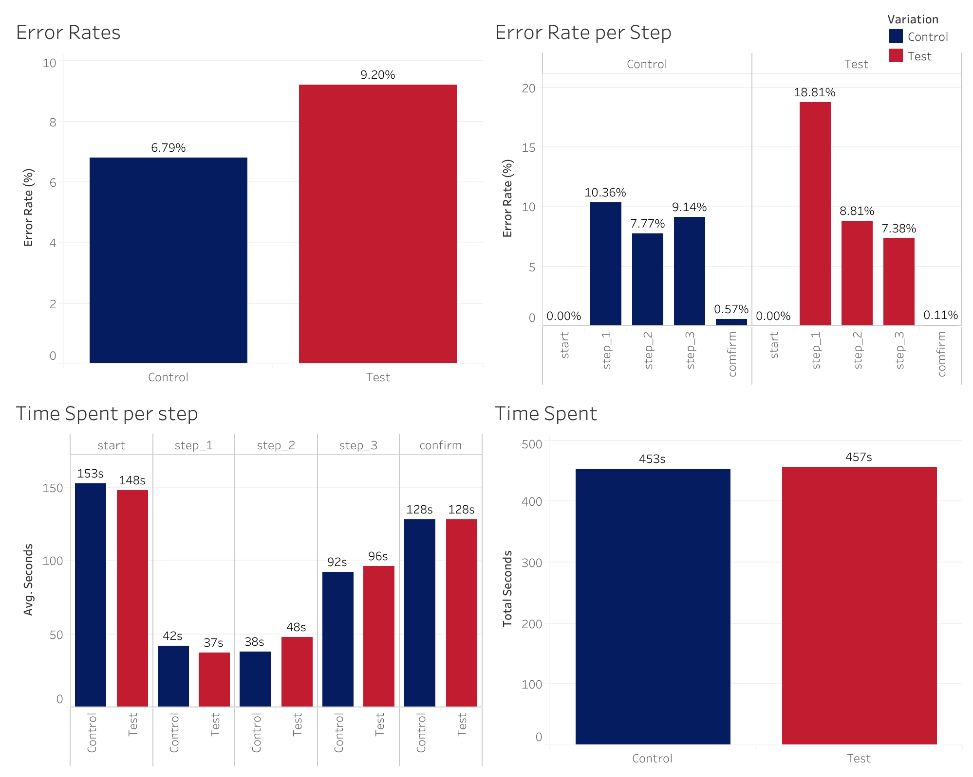
KPIs

Slide 8
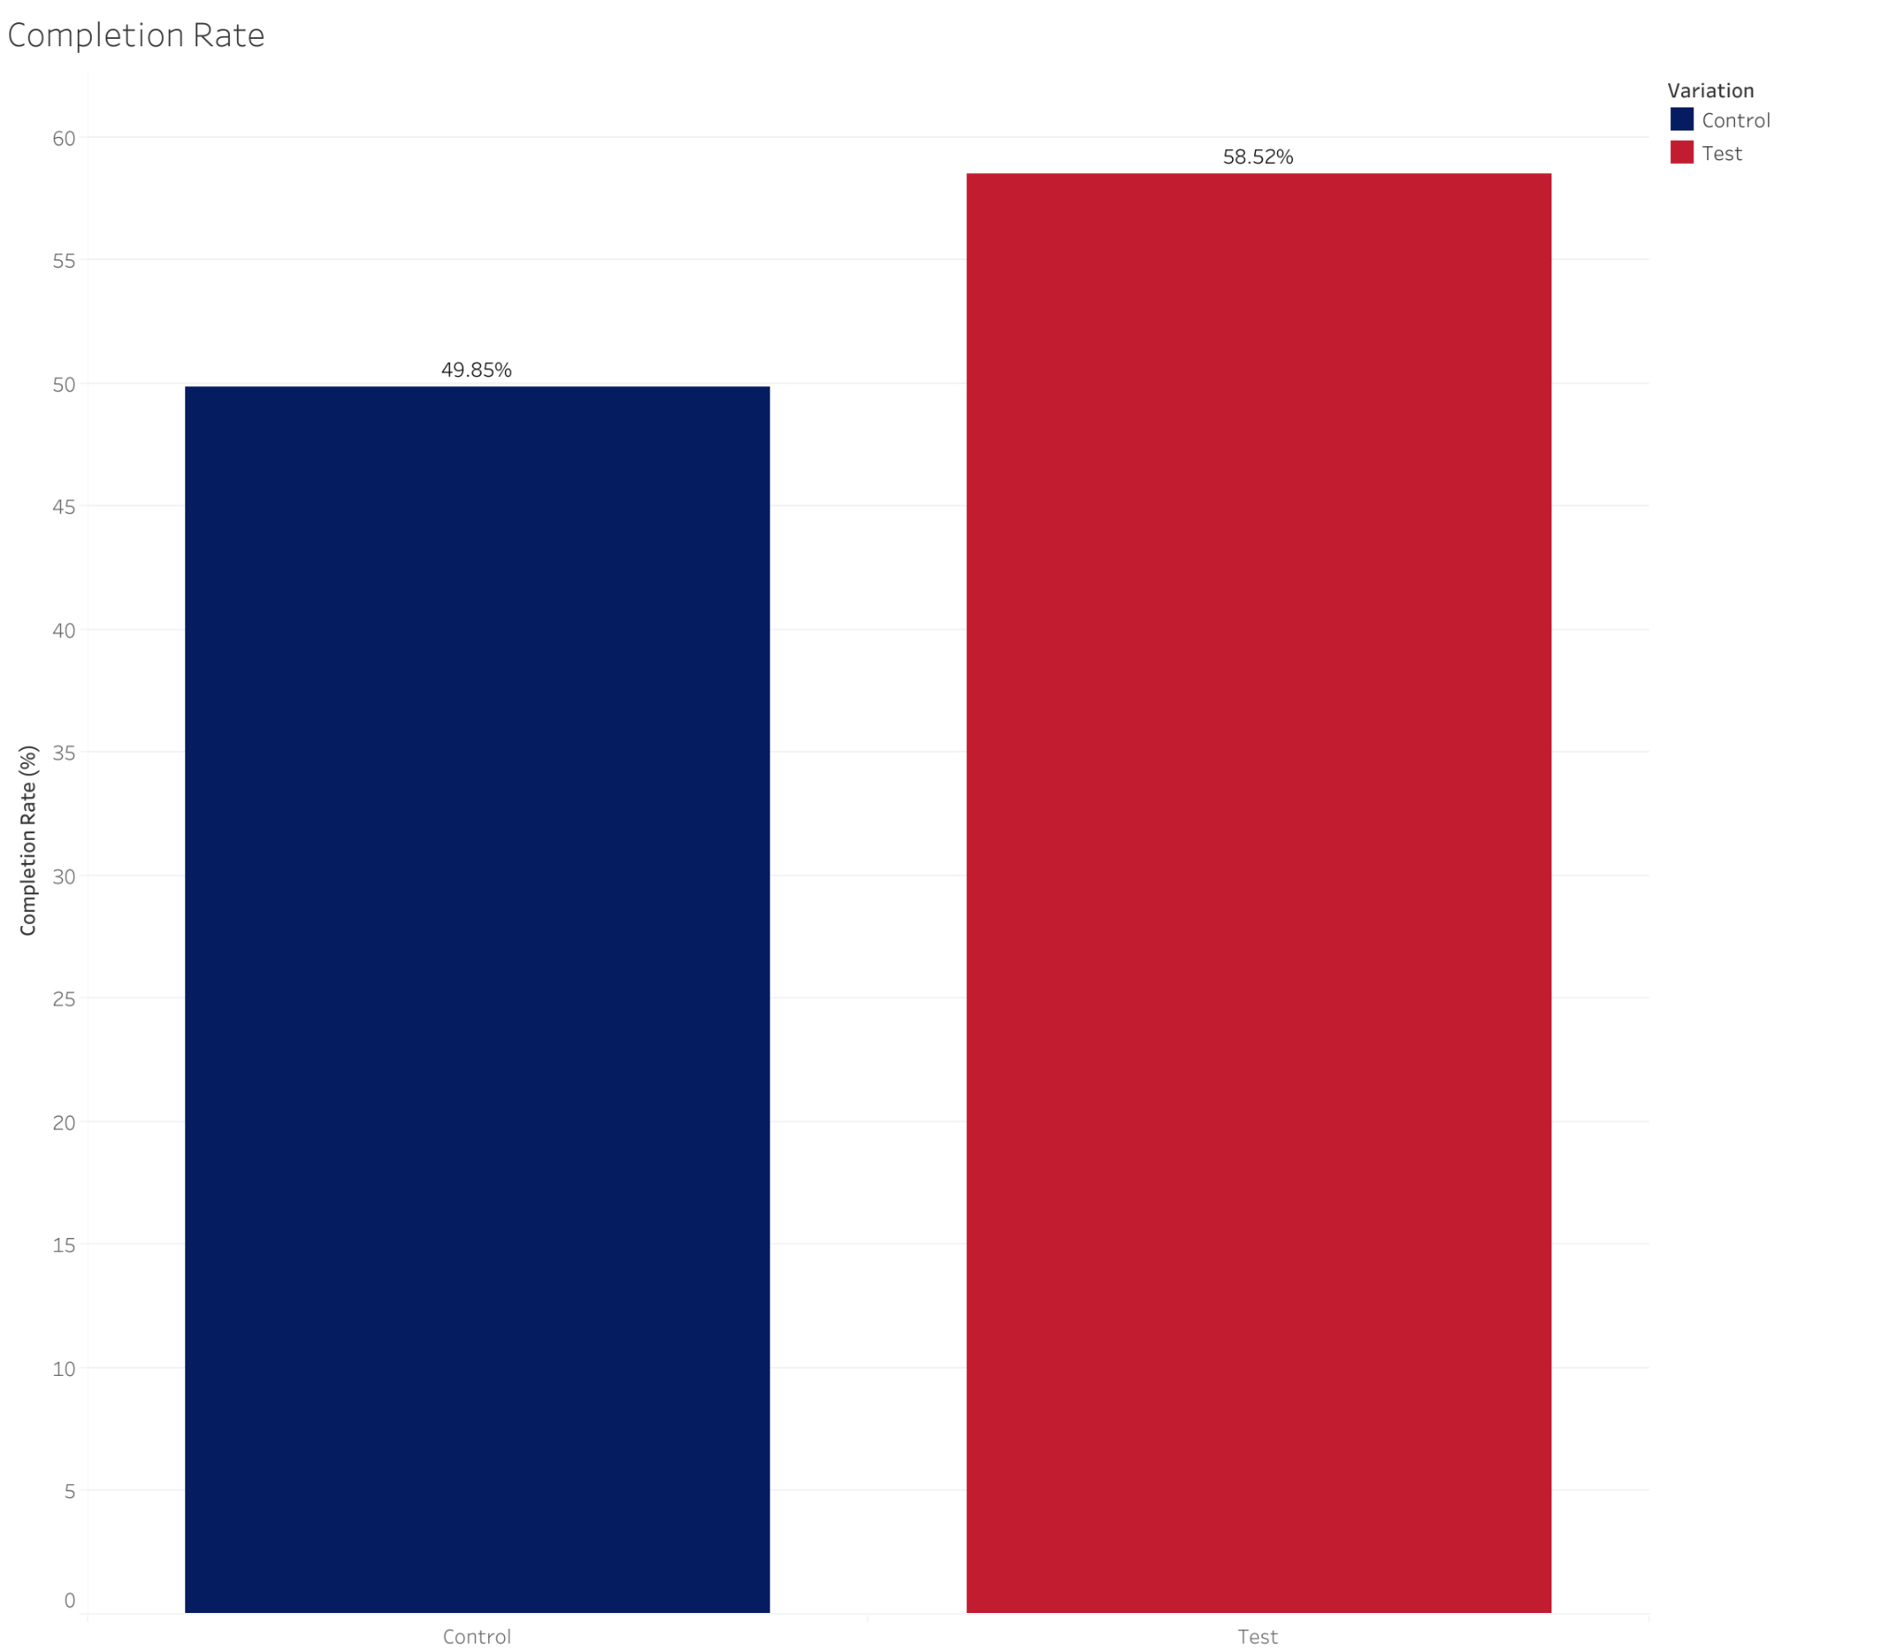
Completion Rate
We considered as completion those who reach the “confirm” step (counted one time per unique visit ID)
T-Test Control >= Test:
T-Statistic:14.70,
P-Value: 4.20e-49
Chi_2-Test Control >= Test:
Chi2 Statistic: 214.70,
P-Value: 1.29e-48
Z-Test Control >= Test:
Z Statistic: 14.66,
P-Value: 1.11e-48

Slide 9
Conclusion
Time Spent
per Step
Error Rate
Completion Rate

Slide 10
Team Work
performance & tools
Trello
Python
Tableau
Canva &
Google Slides
helped us to have an overview of our tasks and keep it on track with a Kanban board
Python and libraries to clean and conduct EDA and inferential statistics
Visualisations and further analysis
For the presentation

Slide 11
Challenges
Connecting Data Frames with Tableau
Not having clear information about the steps (having to define an error rate from assumptions
Learning new Python queries to calculate the Error Rate and statistics

Slide 12
Thank you!!
Gabriela & Davide

